Slide 1
AMATEUR
RADIO
COURSE
Notes:
APRIL 2024 UPDATE:
TECHNICIAN POOL OF 2022 – UPDATE DUE IN 2026
GENERAL POOL OF 2023 – UPDATE DUE IN 2027

Slide 2
Individuals to Recognize
KF7VZV for all his hard work in writing the original version of this course.
KG7TUO for updating and maintaining this version.
KJ7GFS for hours of help with the course material.
WC7R for his continuing support.
AK7SB for her grammatical OCD .
Just for her

Slide 3
ORGANIZATIONS
TO RECOGNIZE

Slide 4

ORGANIZATIONS TO RECOGNIZE

Slide 5
ORGANIZATIONS TO RECOGNIZE
The Cascade Amateur Radio Enthusiasts (C.A.R.E.) is a local Medford club that focuses on training and social events.
This course is sponsored by C.A.R.E.
Morse code classes
Hidden Transmitter hunts

Slide 6
ORGANIZATIONS TO RECOGNIZE
Cascade Amateur Radio Enthusiasts (C.A.R.E.)
Monthly meeting – 2nd Wednesday of every month except December, 6:30pm, Fiesta restaurant
at 1016 N Riverside, Medford, OR 97501.

Slide 7
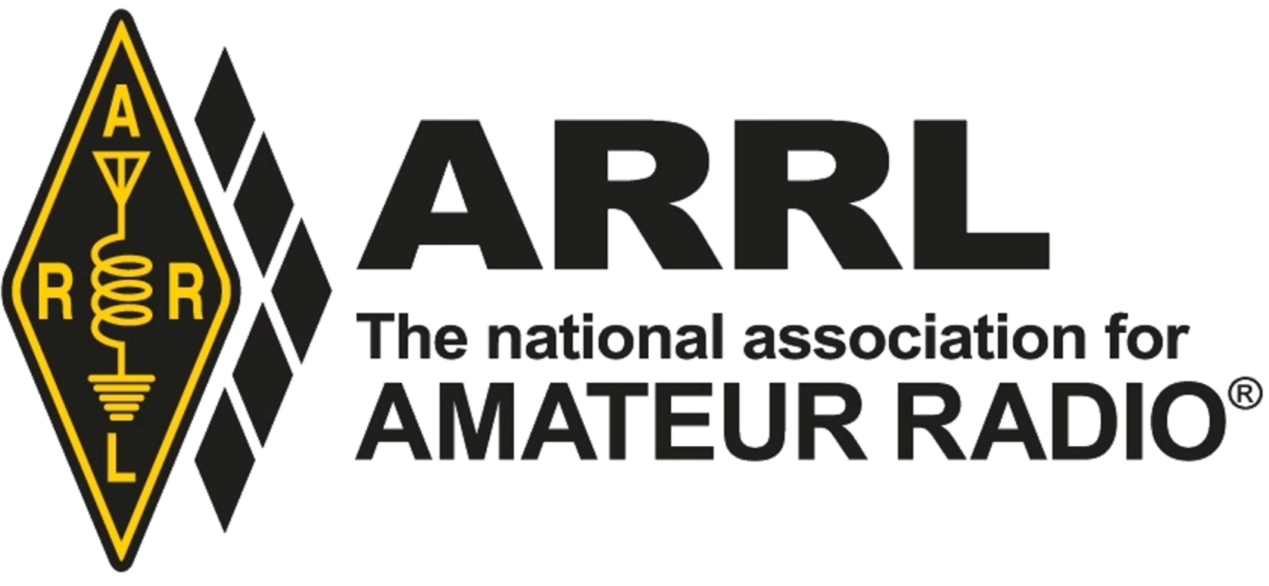
ORGANIZATIONS TO RECOGNIZE

Slide 8
ORGANIZATIONS TO RECOGNIZE
The American Radio Relay League (ARRL) was founded in 1914 by Hiram Percy Maxim. It is a non commercial national association for Amateur Radio in the U.S.
The ARRL published the manuals you’ll use in the course, provides discount insurance to C.A.R.E. so that we can hold courses and events, advocates for Amateur Radio user issues, and much more.

Slide 9
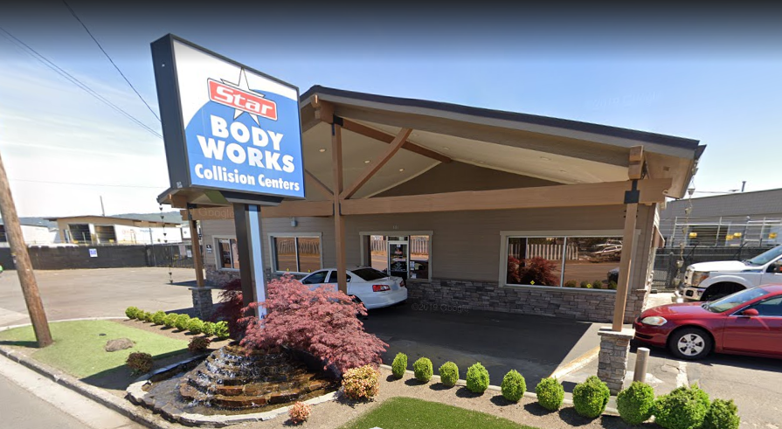
ORGANIZATIONS TO RECOGNIZE
Star Body Works
Star Body Works is kind enough to provide this facility for Club use at not charge.

Slide 10
IS THIS
THE CLASS
FOR YOU

Slide 11
IS THIS THE CLASS FOR YOU
HAM radio is one of many radio services available in the U.S. with varying license requirements.
If you need radio communications for work, a business, or anything else where you have a financial benefit, HAM is NOT the right place.
If all you’re wanting to do is keep track of the kids or grandkids at the campground, GMRS or FRS may be a better match for your needs.

Slide 12
INSTRUCTOR INTRODUCTIONS
Name – CALL SIGN
RADIO FREQUENCIES
PHONE NUMBER
  ANY SPECIAL INSTRUCTIONS
EMAIL

Slide 13
STUDENT INTRODUCTIONS
Your name?
Have you ever used a two way radio?
Why are you taking this course?
What do you know about ham radio?

Slide 14
COURSE OBJECTIVE
Pass the Technician exam which is the entry level and authorizes you to operate an Amateur Radio (HAM) transmitter
Pass the General exam which expands the frequencies and equipment you can use

Slide 15
COURSE OBJECTIVE
If you come to class and study on your own
YOU WILL PASS
Many students pass both tests

Slide 16
EXPECTATIONS
Class starts on time
Be prepared for four to five hours per class, as scheduled.
Read assigned material from both manuals BEFORE class and come ready to learn
PLEASE stay on topic!

Slide 17
COURSE OVERVIEW
SUBJECT
  Introduction
  Safety
  Basic electronics
  Advanced components
  Basic radio and waves
  Antennas and propagation
  Rules and regulations
  Making contact
  Testing session

Slide 18
HAM MANNERS

Slide 19
HAM MANNERS
Use the same manners in class as required when using your radio once licensed.
Inappropriate or vulgar language or stories will NOT be tolerated.
Keep things related to the topic currently at hand.

Slide 20
INTRODUCTION

Slide 21
WHAT IS AMATEUR RADIO
Amateur (or HAM) radio is a radio service authorized by the Federal Communications Commission (FCC).
    To encourage the advancement of the art and science of radio.
    To promote the development of an emergency communication capability to assist communities when needed.

Slide 22
WHY IS HAM RADIO DIFFERENT
Many unlicensed radio services available.
Ham radio is a licensed service:
      Fewer restrictions
      More frequencies (channels or bands to use)
      More power (improves range and quality)
      More ways to communicate

Slide 23
MORE PRIVILEGE = MORE RESPONSIBILITY
Because ham radios are much more capable and have more potential to interfere with other radio services.
&
Because ham radios have unlimited reach. Literally around the planet and into space.
FCC authorization is required to ensure operators are qualified to operate ham equipment safely, appropriately, and within the regulations.
That’s why you’re here.

Slide 24
STEPS TO OBTAINING YOUR LICENSES
Study the material in the manuals.
During class you will see study references to the manuals.
    Tech manual chapters begin with “T”
    General manual chapters begin with “G”
Review the questions in the back of BOTH books

Slide 25
STEPS TO OBTAINING YOUR LICENSES
(cont)
Take interactive practice tests through:
    HamStudy.org
    QRZ.com
    ARRL.org
Pass a 35 question proctored test for TECHNICIAN
Pass a 35 question proctored test for GENERAL
NO MORSE CODE REQUIRED

Slide 26
THE BAD NEWS
The tests are closed book
No cell phones
NO NOTES

Slide 27
THE GOOD NEWS
We have:
    Every question you could be asked
    All the wrong answers
    Better yet All the correct answers
    Everything you may see on your tests
  Verified cleared memory calculators are allowed

Slide 28
WE’RE JUST
THAT
AWESOME

Slide 29
WHY COMBINE
Technician class is entry level & has limitations
    Mostly limited to VHF and UHF short range
General class is the 2nd highest license level
    Access to more frequencies
    More short and long range options
    New technical opportunities
    More fun

Slide 30
WHY COMBINE
(cont)
Most test questions cover the same subjects with the General questions just digging a little deeper.
Because there isn’t a lot of difference, we’ve combined Tech and General to get you the most bang for your money and effort.

Slide 31
AFTER THE TEST SESSION
After the test session the “paperwork” will be forwarded to the FCC.
The FCC will then send applicants an email for payment of fees.
Once fees are paid, your call sign should appear within a couple of business days OR LESS.

Slide 32
VERY
IMPORTANT

Slide 33
FCC RED TAPE
You will be required to obtain from the FCC:
A COmmission REgistration System (CORES) account
A Federal Registration Number (FRN) via CORES
On test day you will be required to provide
Government photo ID (Drivers license)
Your FRN
An email address
Answer the “Felony Question”

Slide 34
CORES ACCOUNT
You should set up your CORES account now as you will need it down the road
CORES is where you will pay your FCC fees such as for initial, renewal, or vanity call signs.
You can access the registration page of CORES by hovering over the “licensing and databases” tab then clicking on “CORES” then clicking on one of the registration links.

Slide 35
EMAIL REQUIRED
On test day you will be asked to provide:
Email address
  However, your username in CORES is an email address so you may as well use the same email for both.
  This address is where the FCC will send official communications, including the link to pay your license fee, so it should be one you monitor routinely and via a permanent provider.
  Many HAM’s, once they have a call sign, create a yahoo or gmail email account of call sign@

Slide 36
FORM 605 FELONY QUESTION
FCC form 605 on which you will apply for your license has a “basic qualification” question commonly known as “the felony question”.
If you have EVER been convicted of ANY FELONY see the handout and/or speak to an instructor early on.
It’s not a big deal, just a slightly different process.

Slide 37
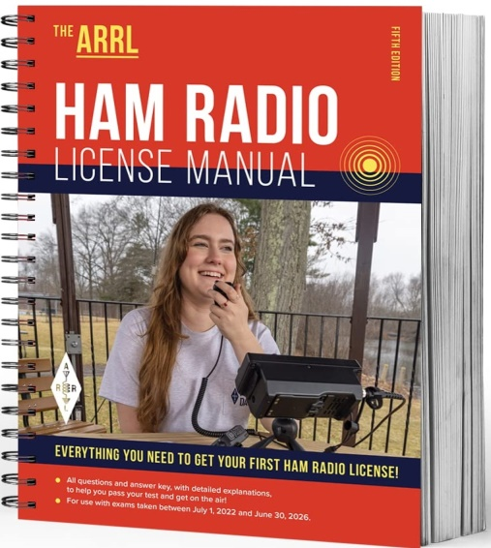
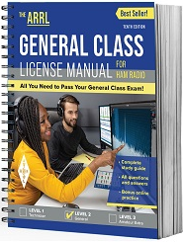
THE MANUALS
FIFTH EDITION
TENTH EDITION

Slide 38
HOW TO USE THE MANUALS
Web site URL’s are in bold print.
Important words or phrases are in italics.
Sidebars contain interesting and helpful information.
Blue boxes within the manuals have more information. DO NOT SKIP THEM they may be the ONLY place questions are explained.
Questions & answers are listed in the back of the manual as well as referenced within the text.

Slide 39
YOU MUST READ THE MATERIAL IN THE MANUALS
In class presentations are time limited. We will expose you to all topics and concepts but simply do not have time to present everything in the manuals.
Read the assigned sections BEFORE CLASS.
NOTE that the course does not go through the manuals chapter by chapter but skips around based on the material being taught.
PAY CLOSE ATTENTION to the reading assignments.
Question numbers do not refer to manual chapters. Look them up in the back of the manual to find them in the text.

Slide 40
GET THE MOST OUT OF CLASS TIME
ASK QUESTIONS
By reading the material before class we will maximize class time
ATTEND CLASSES we can’t back up
There are NO STUPID QUESTIONS
If you have questions between classes, contact an instructor.

Slide 41
GET THE MOST OUT OF CLASS TIME
All class presentations (these slides) are also available at https://www.carehamradio.com/
    If you must miss a class, at least go through the presentation online.

Slide 42
GET THE MOST OUT OF CLASS TIME
USE THE HANDOUTS
    Handouts are available online for you to print, work through, and bring to class.
    Go to Carehamradio.com
    HOVER over “Licensing classes” in the menu bar near the top of the page.
    CLICK on “Class Presentations”
    Scroll down the page to the PRESENTATIONS.
    There will be a link for handouts below all but the first presentation.

Slide 43
GET THE MOST OUT OF CLASS TIME
While fonts and size change, YELLOW text within the training slides means
THIS IS ON THE TEST

Slide 44
WEB LINKS
Cascade Amateur Radio Enthusiasts (C.A.R.E.)
https://www.carehamradio.com/
HamStudy.org
Has practice tests, hints, tips, tricks, etc…..and it’s FREE
https://hamstudy.org/
American Radio Relay League (ARRL)
http://www.arrl.org/
QRZ – A little like Facebook for HAMs but not as crazy
https://www.qrz.com/
Eham – Product reviews (used gear too), forums, etc.
https://www.eham.net/
FCC site to sign up for an FRN
https://apps.fcc.gov/coresWeb/publicHome.do

Slide 45
1st 2-3 WEEKS
Chapters T2/T3/G4
AAAAAHHHH! MATH!!
Study up, and be prepared to memorize some things!

Slide 46


Slide 47
RIGHT NOW
Let’s take a look at SAFETY
(Chapters T9/G9)

