Slide 1
Advanced Components
Active components
Practical circuits
Basic test equipment

Slide 2
Active
Components

Slide 3
Semiconductor Components
Semiconductor Components are:
Materials that do not conduct as well as metals, but better than insulators
Can modify properties by adding controlled amounts of other materials called “dopants”
Notes:
??? RRREDUNDANT WITH PRES 2 - REMOVE

Slide 4
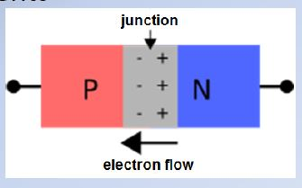
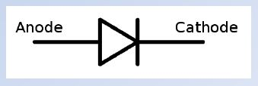
Semiconductor Components
Diodes & Rectifiers
Junction diodes
  A P-N junction diode allows current to flow in only one direction & blocks current flow in the other direction
Notes:
T6B02 –
??? RRREDUNDANT WITH INFO AND QUESTION IN PRES #2

Slide 5
Semiconductor Components
Diodes & Rectifiers
Junction diodes
  Voltage applied in the forward direction is called “forward bias”
  Voltage applied in the reverse direction is called “reverse bias”
+ -

Slide 6
Semiconductor Components
Diodes & Rectifiers
Diode Ratings (must not be exceeded)
  Peak Inverse Voltage (PIV)
    Maximum voltage in the reverse (non-conducting) direction (reverse bias)
Notes:
??? RRREMOVE

Slide 7
Semiconductor Components
Diodes & Rectifiers
Maximum Average Forward Current
Forward Threshold Voltage
  Silicon = 0.7 Volts (approx.)
  Germanium = 0.3 Volts (approx.)
  GaAs (Gallium Arsenide)
  GaAsP (Gallium Arsenide Phosphide) = 1.2 Volts to 1.5 Volts (approx.)
Notes:
G6A05 – G6A03 -

Slide 8
Semiconductor Components
Diodes & Rectifiers
Diodes designed for low-power signals are called “signal” or “switching” diodes
Diodes designed for high power circuits are called “rectifiers”
  Maximum reverse voltage as high as 1000 Volts
  Maximum forward current as high as 200 Amps

Slide 9
Semiconductor Components
Diode Types
  PIN diode
    Low forward voltage drop
    RF switching & control
Notes:
??? RRREMOVE NOT NEEDED

Slide 10
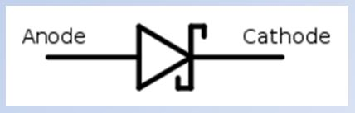
Semiconductor Components
Diode Types
  Schottky Diode
    Low junction capacitance allows operation at VHF & UHF
    Lower forward voltage drop
Notes:
RRREMOVE ??? NOT NEEDED

Slide 11
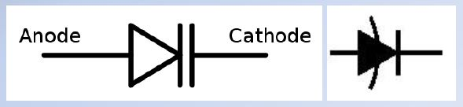
Semiconductor Components
Diode Types
  Varactor Diodes (VariCap)
    Operates with reverse bias
    Varying voltage varies junction capacitance
    Used for variable-frequency oscillators and for FM modulators
Notes:
RRREMOVE ??? NOT NEEDED

Slide 12
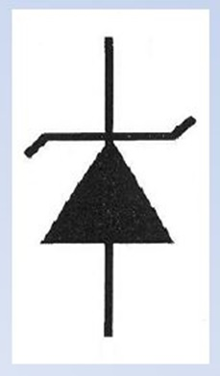
Semiconductor Components
Diode Types
  Zener diode
    Operates with reverse bias
    Operates at avalanche(breakdown) voltage
    Designed to withstand avalanche current with proper heat sink
    Large change in avalanche current results in small change in voltage
Notes:
G7A10 -

Slide 13
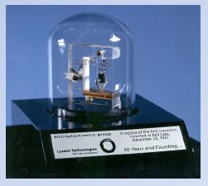
Semiconductor Components
Bipolar & Field-Effect Transistors
Adding another layer to a diode creates a device capable of amplifying a signal
  1st Transistor was created at Bell Labs in late 1947

Slide 14
Semiconductor Components
Bipolar Transistors
A small current flowing between the base-emitter junction controls the large amount of current flowing between the emitter and collector with direction dependent upon type
Bipolar transistors exhibit current gain

Slide 15
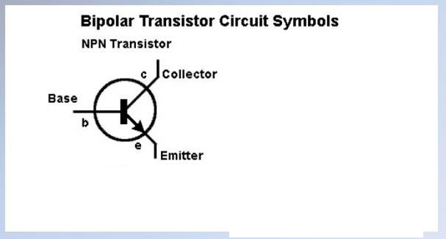
Semiconductor Components
Bipolar Transistors
Notes:
G7A11 –
??? COVERED PARTIALLY IN PRES #2 CONSOLIDATE?? – THIS AND NEXT TEN SLIDES
??? RRREMOVE ?? QUESTION AND TRAINING SLIDE IS ALREADY IN PRES #2 – CONSOLIDATE INTO ONE OR THE OTHER PRESENTATION?

Slide 16
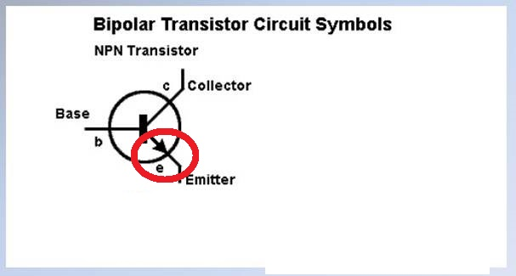
Semiconductor Components
Bipolar Transistors
Notes:
G7A11 -
??? RRREMOVE ?? QUESTION AND TRAINING SLIDE IS ALREADY IN PRES #2 – CONSOLIDATE INTO ONE OR THE OTHER PRESENTATION?

Slide 17
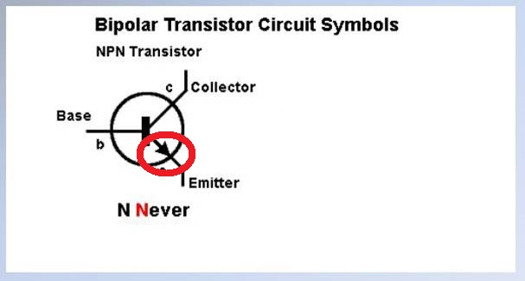
Semiconductor Components
Bipolar Transistors
Notes:
G7A11 -
??? RRREMOVE ?? QUESTION AND TRAINING SLIDE IS ALREADY IN PRES #2 – CONSOLIDATE INTO ONE OR THE OTHER PRESENTATION?

Slide 18
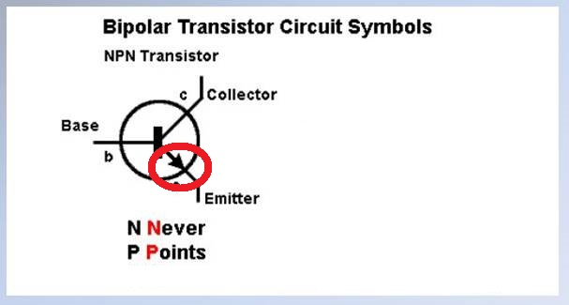
Semiconductor Components
Bipolar Transistors
Notes:
G7A11 -
??? RRREMOVE ?? QUESTION AND TRAINING SLIDE IS ALREADY IN PRES #2 – CONSOLIDATE INTO ONE OR THE OTHER PRESENTATION?

Slide 19
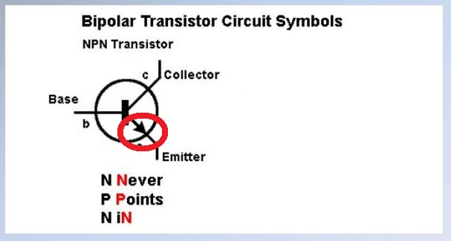
Semiconductor Components
Bipolar Transistors
Notes:
G7A11 -
??? RRREMOVE ?? QUESTION AND TRAINING SLIDE IS ALREADY IN PRES #2 – CONSOLIDATE INTO ONE OR THE OTHER PRESENTATION?

Slide 20
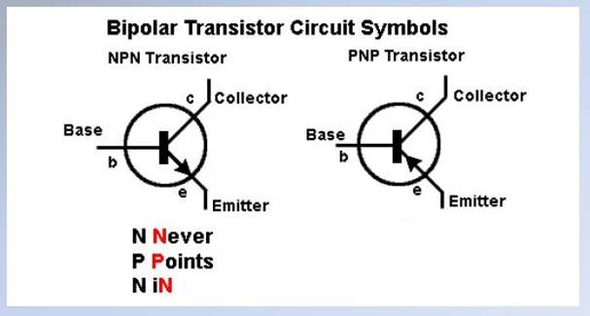
Semiconductor Components
Bipolar Transistors
Notes:
G7A11 -
??? RRREMOVE ?? QUESTION AND TRAINING SLIDE IS ALREADY IN PRES #2 – CONSOLIDATE INTO ONE OR THE OTHER PRESENTATION?

Slide 21
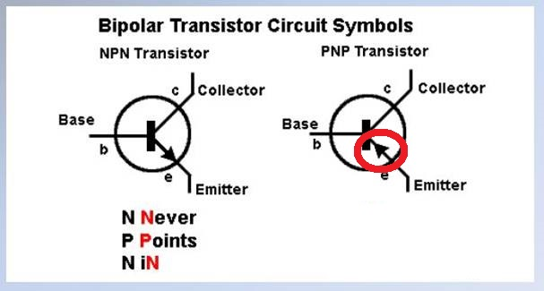
Semiconductor Components
Bipolar Transistors
Notes:
G7A11 -
??? RRREMOVE ?? QUESTION AND TRAINING SLIDE IS ALREADY IN PRES #2 – CONSOLIDATE INTO ONE OR THE OTHER PRESENTATION?

Slide 22
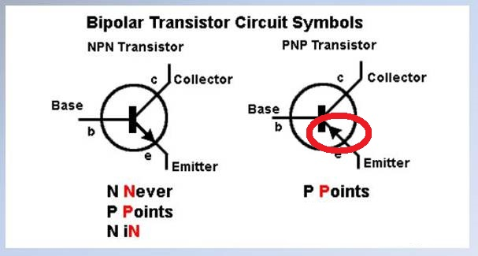
Semiconductor Components
Bipolar Transistors
Notes:
G7A11 -
??? RRREMOVE ?? QUESTION AND TRAINING SLIDE IS ALREADY IN PRES #2 – CONSOLIDATE INTO ONE OR THE OTHER PRESENTATION?

Slide 23
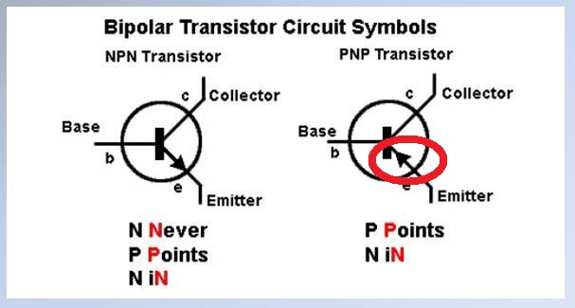
Semiconductor Components
Bipolar Transistors
Notes:
G7A11 -
??? RRREMOVE ?? QUESTION AND TRAINING SLIDE IS ALREADY IN PRES #2 – CONSOLIDATE INTO ONE OR THE OTHER PRESENTATION?

Slide 24
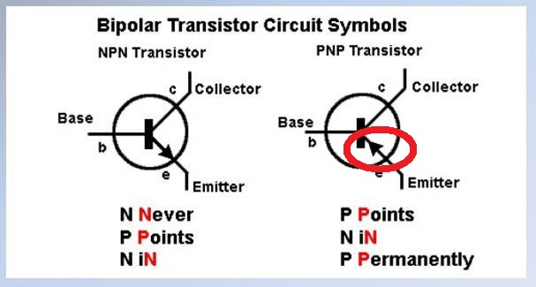
Semiconductor Components
Bipolar Transistors
Notes:
G7A11 -
??? RRREMOVE ?? QUESTION AND TRAINING SLIDE IS ALREADY IN PRES #2 – CONSOLIDATE INTO ONE OR THE OTHER PRESENTATION?

Slide 25
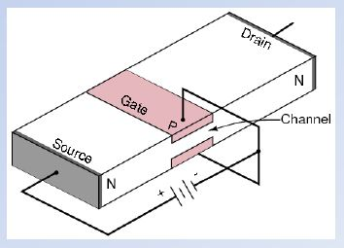
Semiconductor Components
Field-Effect Transistors (FET)
Gate voltage controls channel current
High input impedance
Enhancement Mode adding + charge to turn gate on
Depletion Mode adding
– charge to turn gate off

Slide 26
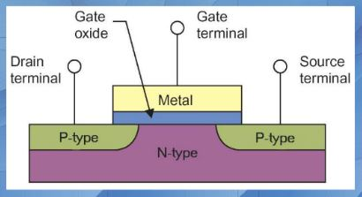
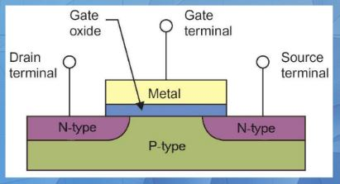
Semiconductor Components
Field-Effect Transistors (FET)
Metal Oxide Semiconductor Field-Effect Transistor (MOSFET)
Gate separated from the channel with a thin insulating layer
N-Channel P-Type
Notes:
G6A09 –
??? RRREVISE - Change colors ???

Slide 27
Semiconductor Components
Bipolar & Field-Effect Transistors
High gain makes both bipolar transistors & FET’s useful as switches
Low base current or low gate voltage* puts transistor into “cutoff” -- little or no current flow
  Additional reduction of base current or gate voltage does not result in any further reduction in current flow
High base current or high gate voltage* puts transistor into “saturation” – maximum current flow
  Additional increase of base current or gate voltage does not result in any further increase in current flow
  * Assuming enhancement-mode FET
Notes:
??? RRREDUCE

Slide 28
Semiconductor Components
Bipolar & Field-Effect Transistors
  The operating points of a bipolar transistor used as a switch are the saturation and cutoff points
  The same is true of FET’s
Notes:
G6A07 -

Slide 29
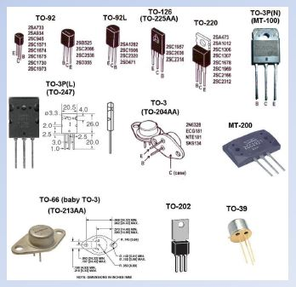
Semiconductor Components
Bipolar & Field-Effect Transistors
Transistors come in wide
variety of packages
Some high-power cases
have collector or source
directly connected to
case
  Better heat transfer
  Must be insulated from
  heat sink or chassis
Notes:
??? CONSOLIDATE

Slide 30
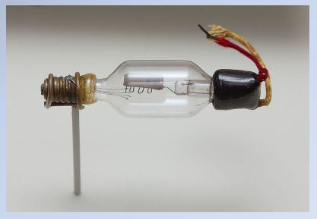
Semiconductor Components
Vacuum Tubes
Oldest amplification device
Invented by Lee De Forest in 1906

Slide 31
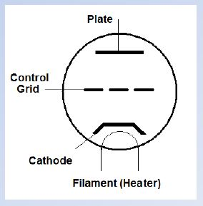
Semiconductor Components
Vacuum Tubes
Triode
Simplest tube capable
of amplification
  3 Elements
    Cathode
    Control Grid (Grid)
    Plate (Anode)

Slide 32
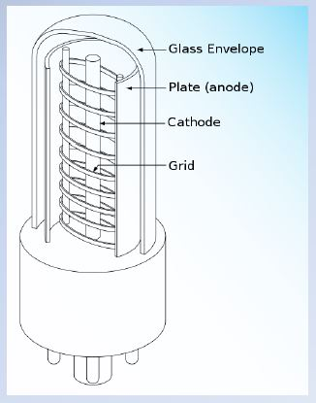
Semiconductor Components
Vacuum Tubes
Control Grid (Grid)
Controls flow of electrons
from cathode to plate
Fine wire mesh
Small negative voltage
Low voltages
Low current
Notes:
G6A10 -

Slide 33
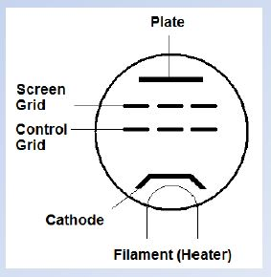
Semiconductor Components
Vacuum Tubes
Tetrode
4 Elements
  Cathode
  Control grid
  Screen grid
  Plate

Slide 34
Semiconductor Components
Vacuum Tubes
Tetrode
Screen Grid
The primary purpose of a screen
grid is to reduce grid to plate
capacitance
Medium positive voltage
150-200 Volts
Low Current
Notes:
G6A12 -

Slide 35
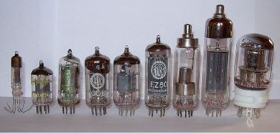
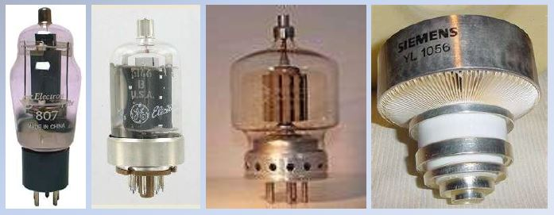
Semiconductor Components
Vacuum Tubes

Slide 36
Semiconductor Components
Analog & Digital Integrated Circuits
Many transistors, diodes, & interconnections can be made on a single silicon wafer almost as easily as a single transistor
A device that combines several semiconductors and other components into one package is called an integrated circuit
Notes:
T6D09 –
??? RRREDUNDANT WITH MATERIAL AND SAME QUESTION IN PRES #2

Slide 37
Semiconductor Components
Analog & Digital Integrated Circuits
Digital integrated circuits
Binary (base2) number system used for digital processing
  Only digits 0 & 1 are used
  Any number can be represented by a string of 0’s & 1’s
        0 = 000, 1 = 001, 2 = 010, 3 = 011, 4 = 100, etc.
  “0” & “1” can be easily represented by the “off” & “on” states of a transistor or similar device

Slide 38
Semiconductor Components
Analog & Digital Integrated Circuits
Complimentary Metal-Oxide Semiconductor (CMOS)
  Replacing TTL
  An advantage of CMOS integrated circuits compared to TTL integrated circuits is low power consumption
  +5V & -5V supply voltage
  Not as susceptible to noise
Notes:
G6B03 –
DEFINE “TTL”
???

Slide 39
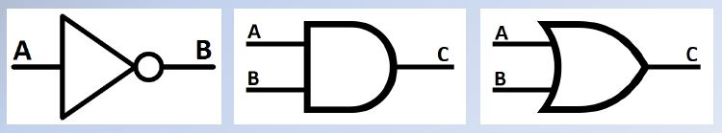
Semiconductor Components
Digital Logic Basics
  Basic building block of a digital circuit is called a “gate”
    NOT (inverting) gate
    AND gate
    OR gate

Slide 40
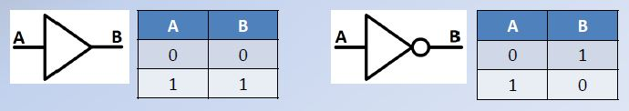
Semiconductor Components
Digital Logic Basics
One-input elements
    Non-inverting buffer
    Inverting buffer or “NOT” gate
Basic Gate NOT Gate

Slide 41
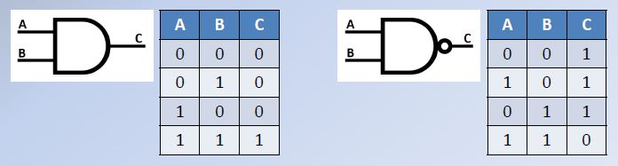
Semiconductor Components
Digital Logic Basics
AND gate
    The function of a two-input AND gate is that output is high only when both inputs are high
NAND (Not-AND) gate
    Output false only if ALL inputs are true
AND NAND
Notes:
G7B03 -

Slide 42
Semiconductor Components
Analog & Digital Integrated Circuits
Operational Amplifier
An integrated circuit operational amplifier is an analog device
    Circuit characteristics totally controlled by external components
    Amplifiers
    Active filters
    Adding signals
Notes:
G6B06 -

Slide 43
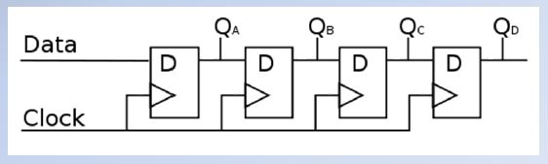
Semiconductor Components
Analog & Digital Integrated Circuits
Digital Logic Basics
Shift Register
  A clocked array of circuits that passes data in steps along the array is Shift Register
  Cascaded D flip-flops
  Converts serial data to parallel data
  Converts parallel data to serial data
Notes:
G7B06 -

Slide 44
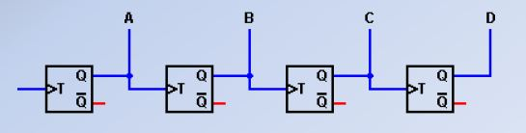
Semiconductor Components
Analog & Digital Integrated Circuits
Digital Logic Basics
Digital Counter
  Cascaded T flip-flops
  Counts number of input pulses
  Number of states = 2 where N = number of stages
  For example: A 3-bit binary counter has 8 states
Notes:
G7B05 -

Slide 45
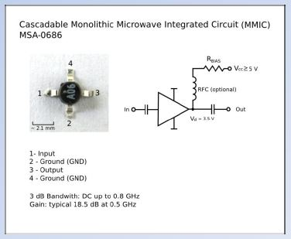
Semiconductor Components
RF Integrated Circuits
Monolithic Microwave Integrated Circuit (MMIC)
VHF, UHF, microwaves
Typically 50Ω
Low Noise Figure
    3.5 dB to 6.0 dB
Microstrip Construction
Notes:
G6B02 -

Slide 46
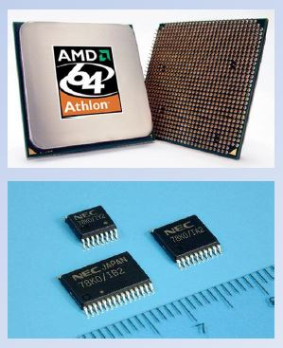
Semiconductor Components
Microprocessors & Related Components
Microprocessor
A computer on a chip
Thousands of gates
Tens of thousands of
transistors & diodes
Microcontroller
Microprocessor with interfaces
to input and output devices
– replaces complex digital circuitry
Notes:
??? RRREMOVE / REDUCE / CONSOLIDATE THIS AND NEXT 5 SLIDES. NONE OF IT IS ON THE TEST

Slide 47
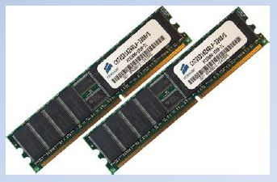
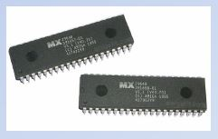
Semiconductor Components
Microprocessors & Related Components
Random Access Memory (RAM)
Volatile
Data lost when powered off
Read-Only Memory (ROM)
Non-Volatile
Data retained when powered off
Notes:
??? RRREMOVE / REDUCE / CONSOLIDATE THIS

Slide 48
Semiconductor Components
Microprocessors & Related Components
Interfaces
  Serial
  One bit transferred at a time
  RS-232 (COM ports)
  Commonly used to connect amateur transceivers to personal computers
  USB (Universal Serial Bus)
  Replacing RS-232
  Commonly used to connect amateur transceivers to personal computers
  Ethernet
Notes:
??? RRREMOVE / REDUCE / CONSOLIDATE THIS

Slide 49
Semiconductor Components
Microprocessors & Related Components
Interfaces
  Parallel
      Multiple bits transferred at a time
      Used for connections to mass storage devices
          Integrated Drive Electronics (IDE)
          Small Computer System Interface (SCSI)
          Centronics® Parallel Printer Port
Notes:
??? RRREMOVE / REDUCE / CONSOLIDATE THIS

Slide 50
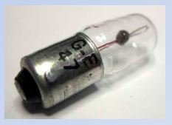
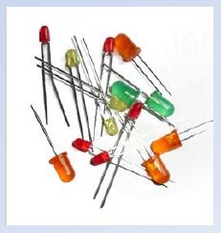
Active Components
Visual Interfaces
Indicator
Displays on/off state of a single item
Incandescent Lamp
Largely replaced by LED’s
Indicator
Faster than incandescent lamp
Uses less power than incandescent lamp
Produces less heat than incandescent lamp
Longer life than incandescent lamP
Notes:
T6B07 –
??? CONSOLIDATE WITH PRES #2 AS IT’S LARGELY A REPEAT

Slide 51
Active Components
Visual Interfaces
Display
  Displays text or graphical information
  Most common type in amateur equipment is the liquid crystal display (LCD) compared to an LED display has higher contrast
      Requires illumination
          Either ambient light or back lighting
Notes:
G6B09 -

Slide 52

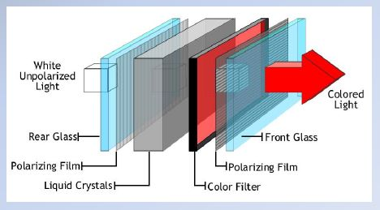
Active Components
Visual Interfaces
Liquid-Crystal Displays
    Rotates polarization of light passing through it
    Applying voltage
    across crystal
    changes
    polarization

Slide 53
Active Components
Ready
for some questions?

Slide 54


G6A03 -- What is the approximate forward threshold voltage of a germanium diode?
0.1 volt
0.3 volts
0.7 volts
1.0 volts
Notes:
(B)

Slide 55
G6A05 -- What is the approximate forward threshold voltage of a silicon junction diode?
0.1 volt
0.3 volts
0.7 volts
1.0 volts
Notes:
(C)

Slide 56
G6A07 -- What are the operating points for a bipolar transistor used as a switch?
Saturation and cutoff
The active region (between cutoff and saturation)
Peak and valley current points
Enhancement and depletion modes
Notes:
(A)

Slide 57
G6A09 -- Which of the following describes MOSFET construction?
The gate is formed by a back-biased junction
The gate is separated from the channel by a thin insulating layer
The source is separated from the drain by a thin insulating layer
The source is formed by depositing metal on silicon
Notes:
(B)

Slide 58
G6A10 -- Which element of a vacuum tube regulates the flow of electrons between cathode and plate?
Control grid
Heater
Screen grid
Trigger electrode
Notes:
(A)

Slide 59
G6A12 -- What is the primary purpose of a screen grid in a vacuum tube?
To reduce grid-to-plate capacitance
To increase efficiency
To increase the control grid resistance
To decrease plate resistance
Notes:
(A)

Slide 60
G6B02 -- What is meant by the term MMIC?
Multi-Mode Integrated Circuit
Monolithic Microwave Integrated Circuit
Metal Monolayer Integrated Circuit
Mode Modulated Integrated Circuit
Notes:
(B)

Slide 61
G6B03 -- Which of the following is an advantage of CMOS integrated circuits compared to TTL integrated circuits?
Low power consumption
High power handling capability
Better suited for RF amplification
Better suited for power supply regulation
Notes:
(A)

Slide 62
G6B06 -- What kind of device is an integrated circuit operational amplifier?
Digital
MMIC
Programmable Logic
Analog
Notes:
(D)

Slide 63
G6B09 -- How does a liquid crystal display compare to an LED display?
Higher contrast in high ambient lighting
Wider dynamic range
Higher power consumption
Shorter lifetime
Notes:
(A)

Slide 64
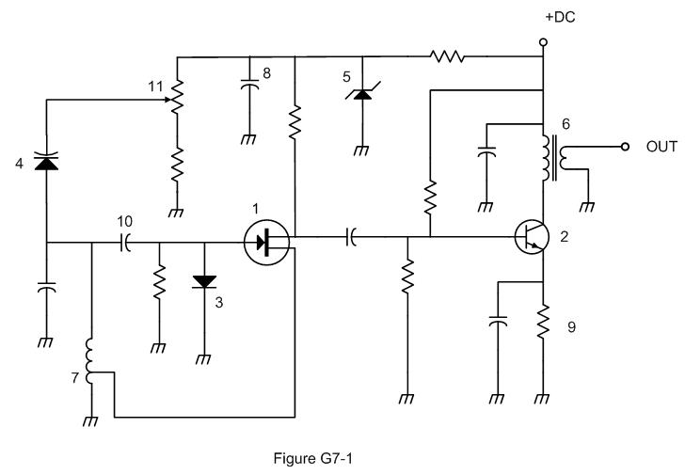
G7A10 -- Which symbol in figure G7-1 represents a Zener diode?
Symbol 4
Symbol 1
Symbol 11
Symbol 5
Notes:
(D)

Slide 65
G7A11 -- Which symbol in figure G7-1 represents an NPN junction transistor?
Symbol 1
Symbol 2
Symbol 7
Symbol 11
Notes:
(B)
??? RRREMOVE ?? QUESTION AND TRAINING SLIDE IS ALREADY IN PRES #2 – CONSOLIDATE INTO ONE OR THE OTHER PRESENTATION?

Slide 66
G7B03 -- Which of the following describes the function of a two-input AND gate?
Output is high when either or both inputs are low
Output is high only when both inputs are high
Output is low when either or both inputs are high
Output is low only when both inputs are high
Notes:
(B)

Slide 67
G7B05 -- How many states does a 3-bit binary counter have?
3
6
8
16
Notes:
(C)

Slide 68
G7B06 -- What is a shift register?
A clocked array of circuits that passes data in steps along the array
An array of operational amplifiers used for tri-state arithmetic operations
A digital mixer
An analog mixer
Notes:
(A)

Slide 69
Practical
Circuits

Slide 70
Rectifiers & Power Supplies
Rectifier Circuits
Half-Wave Rectifier
    Only 180° (one-half) of the AC cycle is converted to DC
    Creates a series of widely-spaced waveform pulses at the frequency of the input voltage
    Very difficult to filter
    The advantageous characteristic of a half-wave rectifier over a full wave rectifier is that it only requires one diode
Notes:
G7A05 - G7A04 -

Slide 71
Rectifiers & Power Supplies
Rectifier Circuits
Full-Wave Rectifier
    360° (all) of the AC cycle is converted to DC power
    The output waveform of an unfiltered full-wave rectifier connected to a resistive load is a series of DC pulses at twice the frequency of the AC input
    Easier to filter
    Uses two diodes and a center-tapped transformer.
Notes:
G7A06 – G7A07 - G7A03 -

Slide 72
Rectifiers & Power Supplies
Rectifier Circuits
Diodes in parallel
  Diodes can be connected in parallel to increase current capacity, ONLY if you put a small-value resistor in series with each diode to equalize the currents between each diode.
Diodes in series
  Diodes can be connected in series to increase voltage capacity, ONLY if you put a large-value resistor in parallel with each diode to equalize the voltage across each diode.
Notes:
??? RRREMOVE OR SHORTEN

Slide 73
Rectifiers & Power Supplies
Power Supply Safety
  Fuse in AC input line
  On/off switch in AC input line
  Bleeder resistor
      Discharges filter capacitors
      High value resistor across output of power supply
Notes:
G7A01 –
??? RRREMOVE ?? ALSO IN PRES #1

Slide 74
Rectifiers & Power Supplies
A regulator circuit controls the amount of voltage from a power supply
Notes:
T6D05 -

Slide 75
Rectifiers & Power Supplies
Switchmode or Switching Power Supplies
High frequency operation of a switchmode power supply allows use of smaller components compared to a linear power supply
Notes:
G7A08 -

Slide 76
Rectifiers & Power Supplies
Switchmode or Switching Power Supplies
Advantages over linear power supplies
      Smaller size
      Less weight
      Higher efficiency
Disadvantages over linear power supplies
      RF noise generation
Notes:
??? RRREMOVE OR REDUCE / CONSOLIDATE

Slide 77
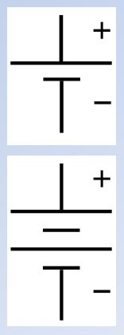
Batteries & Chargers
Batteries
Produce energy by
electrochemical reaction
Used by amateurs for:
      Hand-Held operations
      Portable operations
      Mobile operations
      Emergency operations
Notes:
??? RRREMOVE

Slide 78
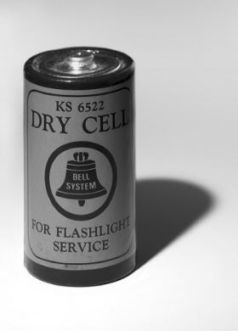
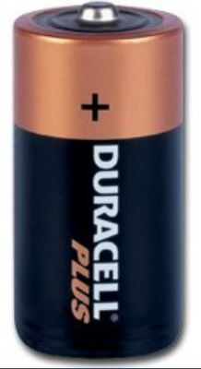
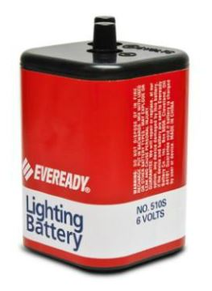
Batteries & Chargers
Batteries
Primary
Electrochemical reaction is
not reversible - NO CHARGING!
Non-Rechargeable Examples:
    Carbon-Zinc
    Alkaline
    Silver-Nickel
    Lithium
    Mercury
    Silver-Oxide
Notes:
T6A11 -

Slide 79
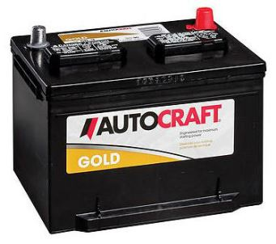
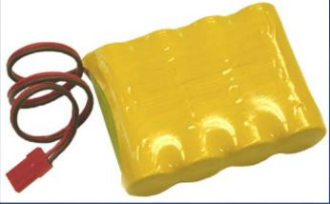
Batteries & Chargers
Batteries
Secondary
      Electrochemical reaction
      is reversible
      Battery can be recharged
      Rechargable Examples:
            Lead-Acid
            Nickel-Cadmium (NiCad)
            Nickel-Metal-Hydride (NiMH)
            Lithium-Ion (Li-Ion)
    HINT: ALL THESE CHOICES ARE CORRECT
Notes:
T6A10 -

Slide 80
Batteries & Chargers
Batteries
Secondary
      The minimum allowable discharge voltage for maximum life of a standard 12-volt lead-acid battery is 10.5 volts
      NOTE: 10.5 is for the test. In the real world do not go below 12 volts on a lead acid battery. 12 volts is 50% and is the lowest you should go. ANYTHING lower will reduce life.
      An advantage of batteries with low internal resistance is their high discharge current
Notes:
G6A01 – G6A02 -

Slide 81
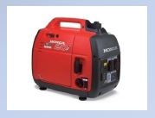
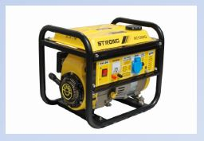
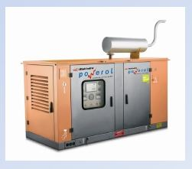
Alternative Power
Generators
    Gasoline, Diesel, Propane fueled
    <1kW to >10kW

Slide 82
Alternative Power
Solar Power - Photovoltaic Conversion
If sufficient light falls on a P-N junction, free electrons in the N-type material will absorb energy & flow across the junction into the P-type material
      Most common material is Silicon
      The open circuit voltage from a fully illuminated silicon photovoltaic cell is approximately 0.5 VDC
      Most efficient material is Gallium-Arsenide
Notes:
G4E09 -

Slide 83
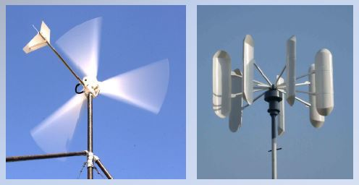
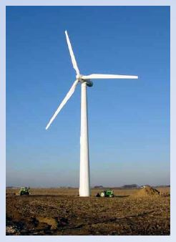
Alternative Power
Wind Power
DC generator attached to propeller

Slide 84
Alternative Power
Energy Storage
  A diode must be connected between a solar panel & storage battery to prevent discharge of the battery through the panel during low-light conditions
  The individual cells in a solar panel are connected in a series-parallel configuration
  When connecting a solar panel to a lithium iron phosphate battery the solar panel must have a charge controller
Notes:
G4E10 - G4E08 – G4E11 -

Slide 85

Connectors
Terminology
Connectors with specially-shaped bodies or pin/socket arrangements are call “keyed connectors”
Avoids damage caused by
mis-mating connectors
Plugs = Connectors installed
on ends of cables
Jacks = Connectors installed
on equipment

Slide 86


Connectors
Terminology (cont’d)
Adapters allow different types
of connectors, or connectors
of the same “gender” to be
connected together
Notes:
??? REMOVE OR CONSOLIDATE

Slide 87

Connectors
Power Connectors
Anderson PowerPole® Connectors
Becoming increasingly common for station interconnections
Easy to install with proper crimp tool
Notes:
??? REMOVE OR CONSOLIDATE

Slide 88


Connectors
Power Connectors
    Terminal Strips
Notes:
??? REMOVE OR CONSOLIDATE

Slide 89

Connectors
Audio and Control Connectors
Phone plugs & jacks (TRS connectors)
      Audio
      Keys
      Control signals
      Sizes:
          Standard -- 1/4” dia.
          Aircraft -- 0.206” dia.
          Miniature -- 1/8” (3.5 mm) dia.
          Sub-miniature -- 3/32” (2.5 mm) dia.
Notes:
??? REMOVE OR CONSOLIDATE

Slide 90


Connectors
Audio and Control Connectors
RCA Phono plugs & jacks
      Commonly used for low frequency or dc signal connections to a transceiver
Notes:
G6B12 -

Slide 91


Connectors
RF Connectors
HF/VHF
      Plug = PL-259
      Socket = SO-239
      Pl-259 is commonly used at HF and VHF frequencies
      ≥ 1.5 kW
      Not weather resistant
      Relatively Inexpensive
Notes:
T9B07 -

Slide 92

Connectors
RF Connectors
Type N
    Most suitable above 400 MHz
    Moisture-resistant
    Useful to 10 GHz
    ≥ 1.5 kW
    Constant impedance
        50 Ω or 75 Ω versions
        available
      More expensive than UHF
      connectors
Notes:
T9B06 - G6B07 –

Slide 93


Connectors
RF Connectors
BNC
      Typical upper frequency limit for low SWR operation of 50-ohm BNC connectors is 4 GHz
      50 Ω or 75 Ω
Notes:
G6B04 -

Slide 94

Connectors
RF Connectors
SMA
    A small threaded connector suitable for signals up to several GHz
    up to 18 GHz
    Low Power
        50 Ω
Notes:
G6B11 -

Slide 95

Connectors
Data Connectors
    USB Connectors
          USB replacing RS-232
          Many manufacturers making devices to interconnect transceivers & other station equipment using USB
Notes:
??? RRREMOVE OR CONSOLIDATE

Slide 96
G4E08 -- In what configuration are the individual cells in a solar panel connected together?
A. Series-parallel
B. Shunt
C. Bypass
D. Full-wave bridge
Notes:
(A)

Slide 97
G4E09 -- What is the approximate open-circuit voltage from a a fully illuminated silicon photovoltaic cell?
A. 0.02 VDC
B. 0.5 VDC
C. 0.2 VDC
D. 1.38 VDC
Notes:
(B)

Slide 98
G6B04 -- What is a typical upper frequency limit for low SWR operation of 50-ohm BNC connectors?
50 MHz
500 Mhz
4 GHz
40 GHz
Notes:
(B)

Slide 99
G4E10 -- Why should a series diode be connected between a solar panel and a storage battery that is being charged by the panel?
To prevent overload by regulating the charging voltage
To prevent discharge of the battery through the panel during times of low or no illumination
To limit the current flowing from the panel to a safe value
To prevent damage to the battery due to excessive voltage at high illumination levels
Notes:
(B)

Slide 100
G4E11 -- What precaution should be taken when connecting a solar panel to a lithium iron phosphate battery?
Ground the solar panel outer metal framework
Ensure the battery is placed terminals-up
A series resistor must be in place
The solar panel must have a charge controller
Notes:
(D)

Slide 101
G6A01 -- What is the minimum allowable discharge voltage for maximum life of a standard 12-volt lead-acid battery?
A. 6 volts
B. 8.5 volts
C. 10.5 volts
D. 12 volts
Notes:
(C)
Relocate or write training slide

Slide 102
G6A02 -- What is an advantage of batteries with low internal resistance?
A. Long life
B. High discharge current
C. High voltage
D. Rapid recharge
Notes:
(B)
Relocate or write training slide

Slide 103

T6A10 -- Which of the following battery chemistries is rechargeable?
A. Nickel-metal hydride
B. Lithium-ion
C. Lead-acid
D. All these choices are correct
Notes:
(D)

Slide 104
T9B06 -- Which of the following RF connector types is most suitable for frequencies above 400 MHz?
A. UHF (PL-259/SO-239)
B. Type N
C. RS-213
D. DB-25
Notes:
(B)

Slide 105
T6A11 -- Which of the following battery chemistries is not rechargeable?
A. Nickel-cadmium
B. Carbon-zinc
C. Lead-acid
D. Lithium-ion
Notes:
(B)

Slide 106

(T6D05) What type of circuit controls the amount of voltage from a power supply?
A. Regulator
B. Oscillator
C. Filter
D. Phase inverter
Notes:
(A)

Slide 107
T9B07 -- Which of the following is true of PL-259 type coax connectors?
A. They are preferred for microwave operation
B. They are watertight
C. They are commonly used at HF and VHF frequencies
D. They are a bayonet-type connector
Notes:
(C)

Slide 108
G6B12 -- Which of these connector types is commonly used for low frequency or dc signal connections to a transceiver?
A. PL-259
B. BNC
C. RCA Phono
D. Type N
Notes:
(C)

Slide 109
G6B11 -- What is an SMA connector?
A type-S to type-M adaptor
A small threaded connector suitable for signals up to several GHz
A connector designed for serial multiple access signals
A type of push-on connector intended for high-voltage applications
Notes:
(B)

Slide 110
G6B07 -- Which of the following describes a type-N connector?
A moisture-resistant RF connector useful to 10 GHz
A small bayonet connector used for data circuits
A low noise figure VHF connector
A nickel plated version of the PL-259
Notes:
(A)

Slide 111
G7A01 -- What is the function of a power supply bleeder resistor?
It acts as a fuse for excess voltage
It discharges the filter capacitors when power is removed
It removes shock hazards from the induction coils
It eliminates ground-loop current
Notes:
(B)
??? RRREMOVE ?? ALSO IN PRES #1

Slide 112
G7A05 -- What portion of the AC cycle is converted to DC by a half-wave rectifier?
A. 90 degrees
B. 180 degrees
C. 270 degrees
D. 360 degrees
Notes:
(B)

Slide 113
G7A06 -- What portion of the AC cycle is converted to DC by a full-wave rectifier?
A. 90 degrees
B. 180 degrees
C. 270 degrees
D. 360 degrees
Notes:
(D)

Slide 114
G7A03 -- Which type of rectifier circuit uses two diodes and a center-tapped transformer?
Full-wave
Half-wave
Full-wave bridge
Synchronous
Notes:
(A)

Slide 115
G7A04 -- What is characteristic of a half-wave rectifier in a power supply?
Only one diode is required
The ripple frequency is twice that of a full-wave rectifier
More current can be drawn from the half-wave rectifier
The output voltage is two times the peak input voltage
Notes:
(A)

Slide 116
G7A07 -- What is the output waveform of an unfiltered full-wave rectifier connected to a resistive load?
A series of DC pulses at twice the frequency of the AC input
A series of DC pulses at the same frequency as the AC input
A sine wave at half the frequency of the AC input
A steady DC voltage
Notes:
(A)

Slide 117
G7A08 -- Which of the following is characteristic of a switchmode power supply as compared to a linear power supply?
Faster switching time makes higher output voltage possible
Fewer circuit components are required
High frequency operation allows the use of smaller components
Inherently more stable
Notes:
(C)

Slide 118
Basic Test Equipment

Slide 119



Analog & Digital Meters
Multimeters
Accuracy expressed in % of full scale
      If accuracy is 2% of full scale on
      100 mA scale, then accuracy is +/-2 mA
Resolution (precision) expressed in digits
      Typically 3 digits, e.g. (0.000 to 1.999)
DO NOT CONFUSE RESOLUTION WITH ACCURACY!
Notes:
??? RRREMOVE OR CONSOLIDATE ??

Slide 120
Analog & Digital Meters
Multimeters
Analog
      D’Arsonval movement
          Rotating coil suspended between
          permanent magnets
          When current flows in coil, coil
          rotates moving needle across scale
          Coil impedance affects accuracy
Sensitivity expressed in Ohms/Volt
    20,000 Ω/V = very good analog meter
Notes:
??? RRREMOVE OR CONSOLIDATE ??

Slide 121
Analog & Digital Meters
Vacuum Tube Voltmeters
      D’Arsonval movement
      Uses a vacuum tube amplifier
      to improve sensitivity
            Typically 10 MΩ/Vor greater
Ensure that the voltmeter and leads are rated for use at the voltages to be measured.
Notes:
T0A12 –
??? RRREMOVE OR CONSOLIDATE ??

Slide 122
Analog & Digital Meters
Digital Meters
    Uses high input impedance
    FET amplifier to improve
    sensitivity
          Typically 10 MΩ/V or greater
    Uses internal microprocessor
    to perform measurement
    calculations

Slide 123
Analog & Digital Meters
Analog Meters
    Faster response times
    Preferred to a digital multimeter when adjusting a circuit for maximum or minimum values
      Example tuning an amplifier
Digital Meters
    Higher sensitivity
    Advantage of a digital meter as compared to an analog multimeter is higher precision
Notes:
G4B09 - G4B06

Slide 124
Analog & Digital Meters
  Voltmeters have high input impedance to decrease the loading on circuits being measured
Notes:
G4B05 -

Slide 125
The Oscilloscope
Displays voltage versus time
      Signal applied to vertical deflection plates
      Sawtooth waveform from a time base applied to horizontal deflection plates
      Contains vertical and horizontal channel amplifiers
Bandwidth of vertical amplifier determines highest frequency signal that can be displayed
Sometimes 2 or more vertical amplifiers
      Allows displaying multiple signals simultaneously
Notes:
G4B01 –
??? REDUCE OR CONSOLIDATE ??

Slide 126

The Oscilloscope
When checking the RF envelope pattern of a transmitted signal the attenuated RF output of the transmitter is connected to the vertical input of the oscilloscope
      Best instrument for checking keying waveform of CW transmission
      Can measure complex waveforms
Notes:
G4B04 - G4B03 - G4B02 –

Slide 127

Service Monitors
Equipment designed for testing
communications equipment
  Precise measurements
  Signal generator
  Frequency counter
  Power meter
Notes:
??? RRREMOVE ??

Slide 128

Impedance & Resonance Measurements
Antenna Analyzer
Connect to antenna & feedline
to measure:
    Standing-wave-ratio (SWR)
    Impedance of coaxial cable
    Resistance & Reactance
    Cable velocity factor,
    impedance & electrical length
    Distance to fault
Notes:
G4B11 – G4B13 -

Slide 129
Impedance & Resonance Measurements
Antenna Analyzer
Connect to antenna & feedline
to measure:
    Used to determine if an antenna is resonant at the desired operating frequency
    Strong signals from nearby transmitters can cause an analyzer to receive power that interferes with SWR readings
Notes:
T7C02 - G4B12 -

Slide 130
Field Strength & RF Power Meters
Field Strength Meters
        Measures RF field strength
        Determine antenna radiation pattern
        Can be used for close-in direction finding
Notes:
G0A09 –
??? ALSO IN PRESENTATION #1

Slide 131


Field Strength & RF Power Meters
RF Power Meters
    Directional Wattmeter
        Determine SWR
        Measure forward power
        Measure reflected power
Notes:
G4B10 -

Slide 132
G4B01 -- What item of test equipment contains horizontal and vertical channel amplifiers?
An ohmmeter
A signal generator
An ammeter
An oscilloscope
Notes:
(D)

Slide 133
G4B02 -- Which of the following is an advantage of an oscilloscope versus a digital voltmeter?
An oscilloscope uses less power
Complex impedances can be easily measured
Greater precision
Complex waveforms can be measured
Notes:
(D)

Slide 134
G4B03 -- Which of the following is the best instrument to use when checking the keying waveform of a CW transmitter?
An oscilloscope
A field strength meter
A sidetone monitor
A wavemeter
Notes:
(A)

Slide 135
G4B04 -- What signal source is connected to the vertical input of an oscilloscope when checking the RF envelope pattern of a transmitted signal?
The local oscillator of the transmitter
An external RF oscillator
The transmitter balanced mixer output
The attenuated RF output of the transmitter
Notes:
(D)

Slide 136
T0A12 -- Which of the following precautions should be taken when measuring high voltages with a voltmeter?
Ensure that the voltmeter has very low impedance
Ensure that the voltmeter and leads are rated for use at the voltages to be measured
Ensure that the circuit is grounded through the voltmeter
Ensure that the voltmeter is set to the correct frequency
Notes:
(B)

Slide 137
G4B05 -- Why do voltmeters have high input impedance?
It improves the frequency response
It allows for higher voltages to be safely measured
It improves the resolution of the readings
It decreases the loading on circuits being measured
Notes:
(D)

Slide 138
G4B06 -- What is an advantage of a digital multimeter as compared to an analog multimeter?
Better for measuring computer circuits
Less prone to overload
Higher precision
Faster response
Notes:
(C)

Slide 139
G4B09 -- When is an analog multimeter preferred to a digital multimeter?
When testing logic circuits
When high precision is desired
When measuring the frequency of an oscillator
When adjusting circuits for maximum or minimum values
Notes:
(D)

Slide 140
G4B10 -- Which of the following can be determined with a directional wattmeter?
Standing wave ratio
Antenna front-to-back ratio
RF interference
Radio wave propagation
Notes:
(A)

Slide 141
G4B11 -- Which of the following must be connected to an antenna analyzer when it is being used for SWR measurements?
Receiver
Transmitter
Antenna and feed line
All these choices are correct
Notes:
(C)

Slide 142
G4B12 -- What effect can strong signals from nearby transmitters have on an antenna analyzer?
Desensitization which can cause intermodulation products which interfere with impedance readings
Received power that interferes with SWR readings
Generation of harmonics which interfere with frequency readings
All these choices are correct
Notes:
(B)

Slide 143
G4B13 -- Which of the following can be measured with an antenna analyzer?
Front-to-back ratio of an antenna
Power output from a transmitter
Impedance of coaxial cable
Gain of a directional antenna
Notes:
(C)

Slide 144

QUESTIONS?

Slide 145
Next Week
Chapters
T2, T3, T5, G5, G6
Basic Radio
And
Radio Waves

